Slide 1
Tutorial Week 7 Modern CNN Architectures
Reference: https://www.youtube.com/watch?v=QzCjXqFnWPE

Slide 2

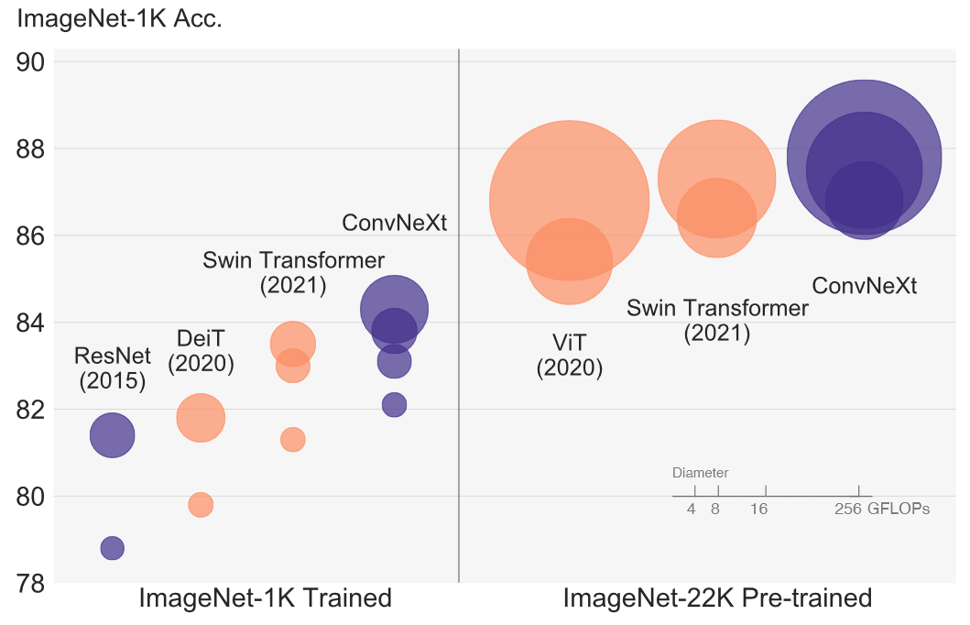

Slide 3
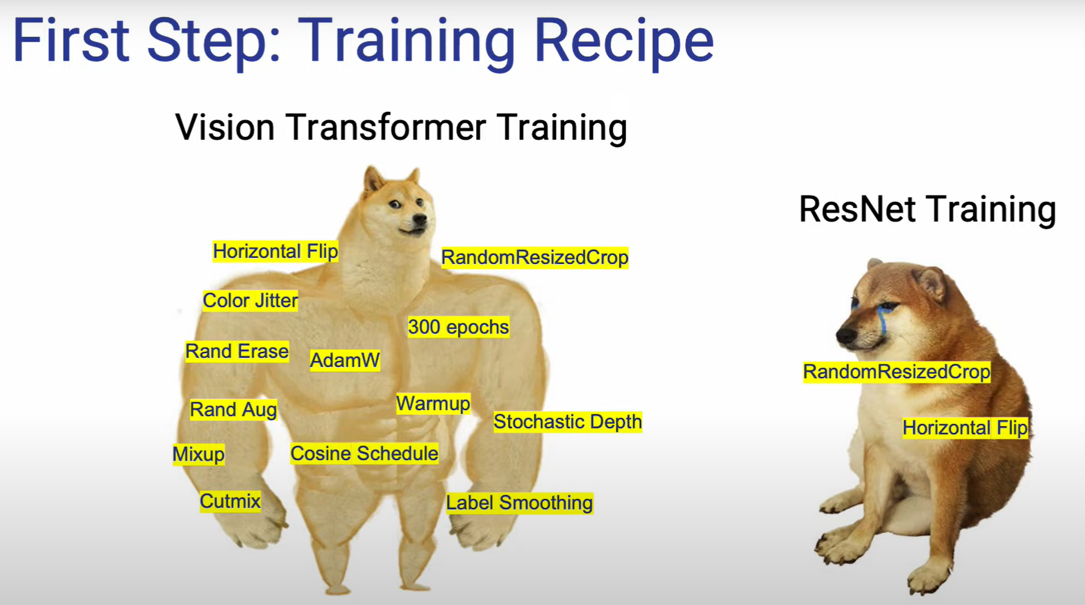

Slide 4
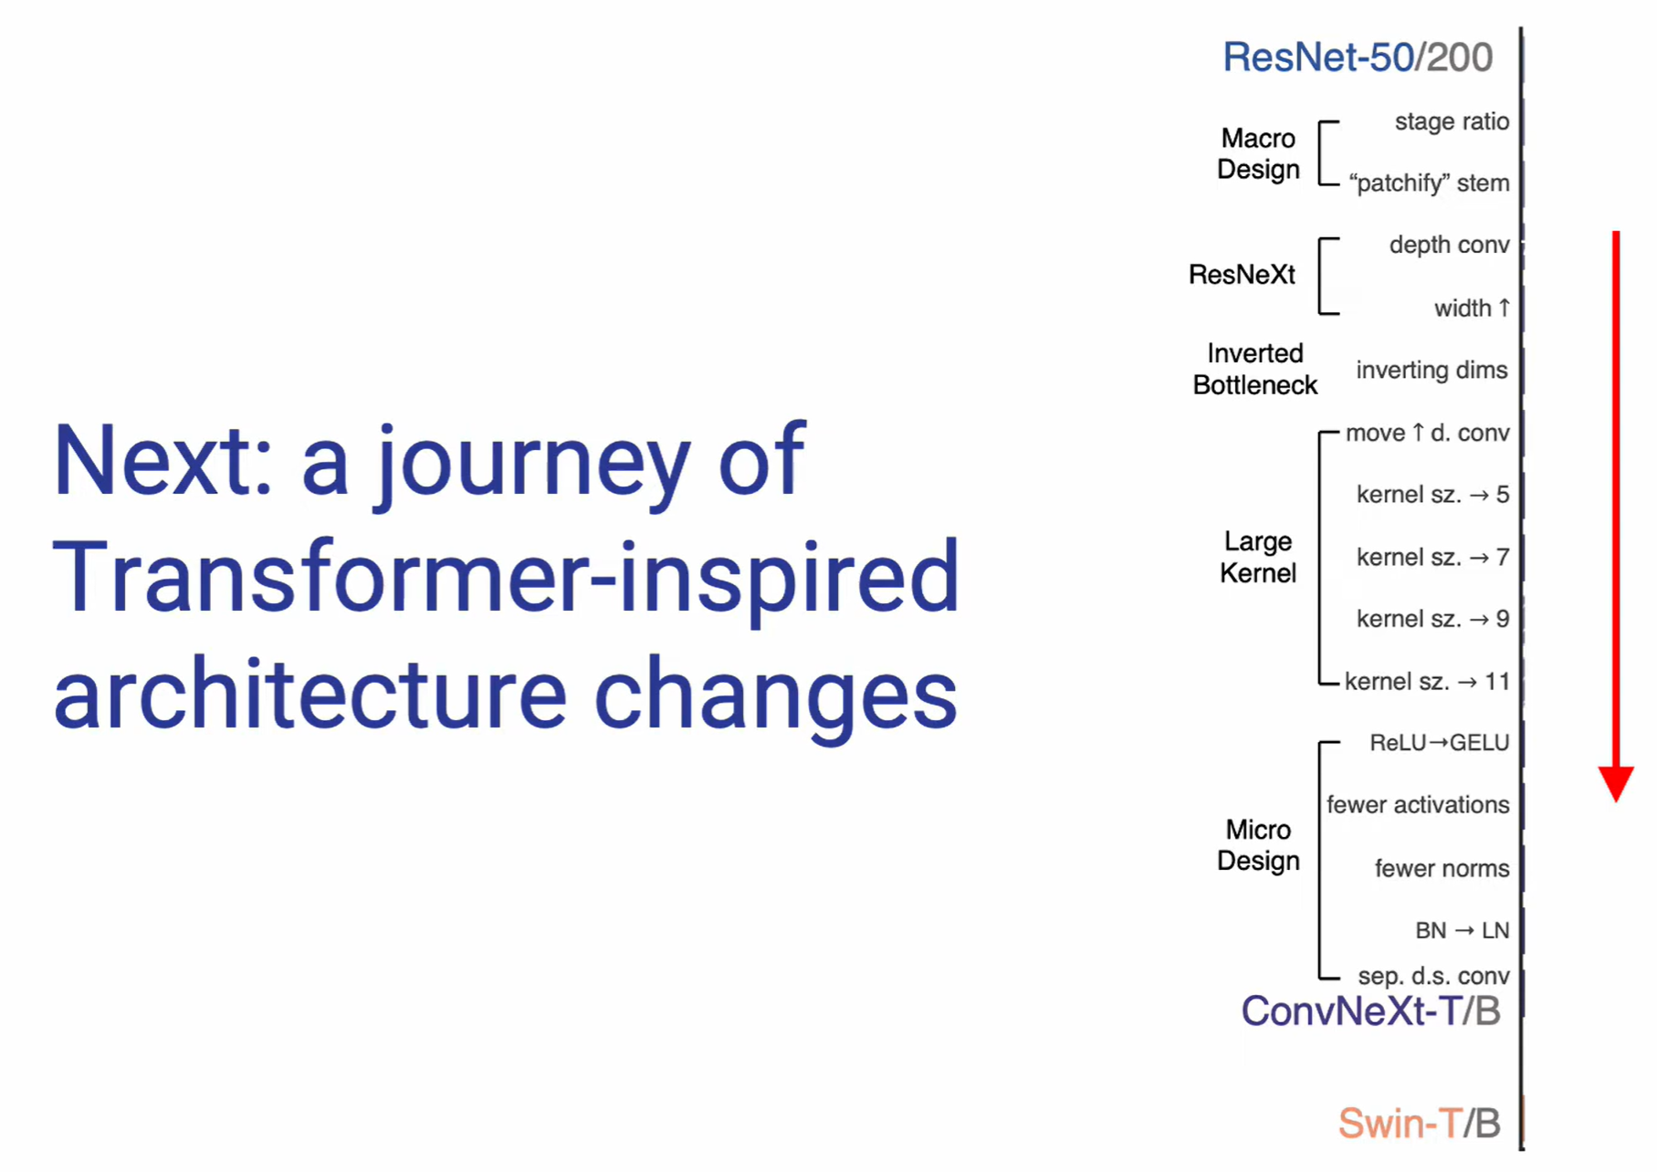

Slide 5
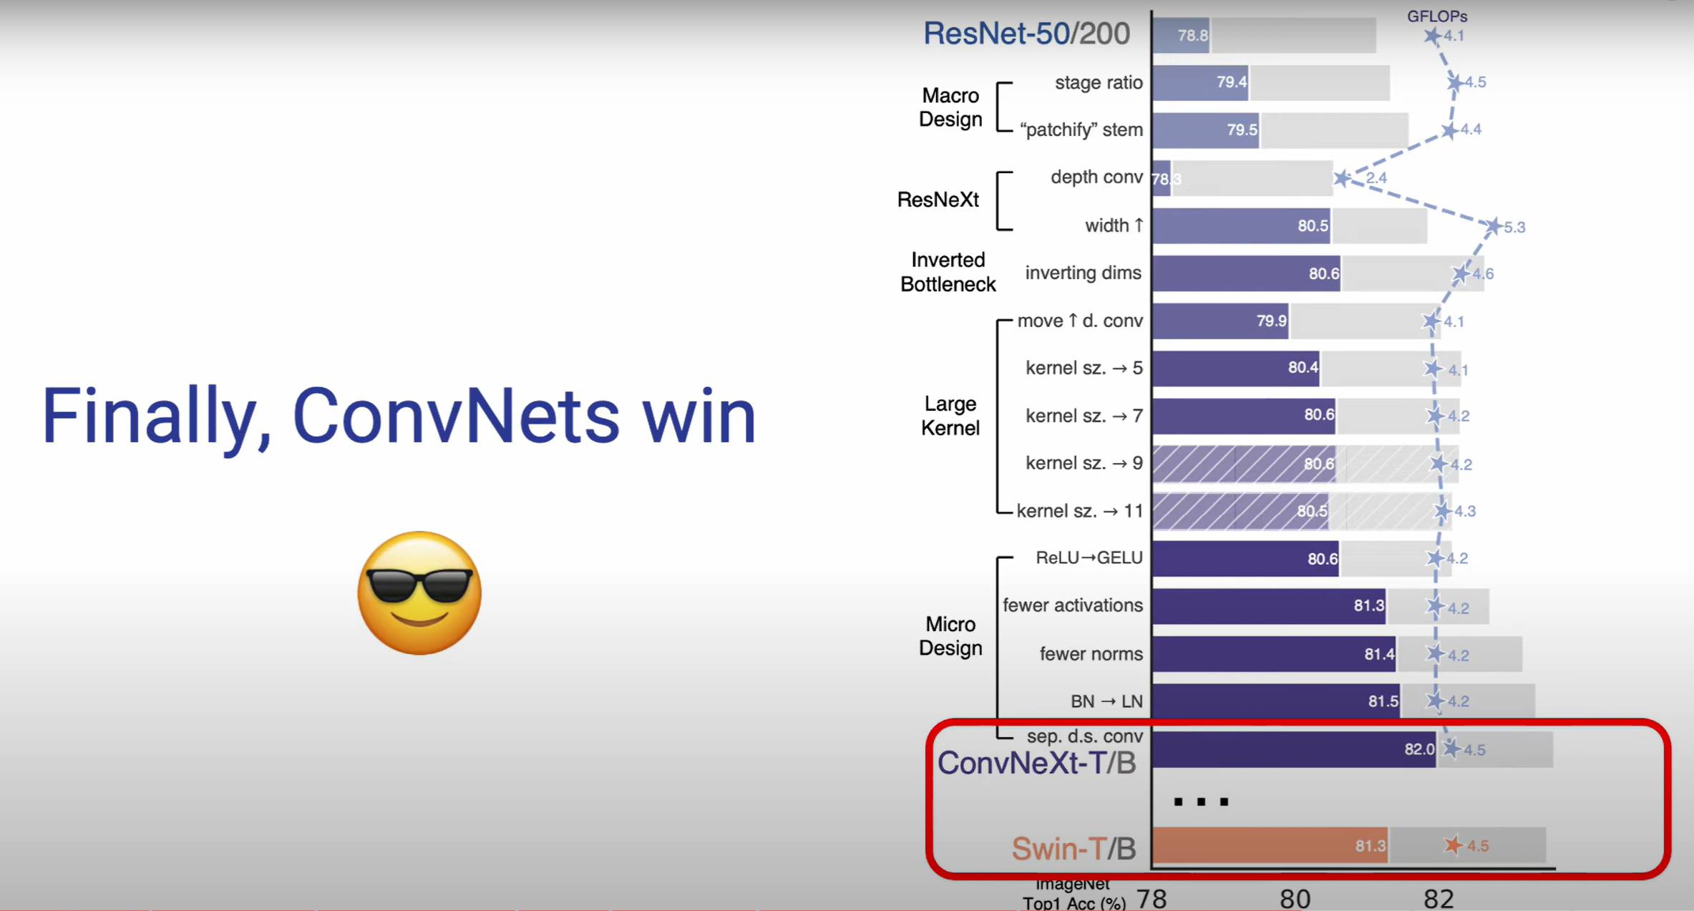

Slide 6
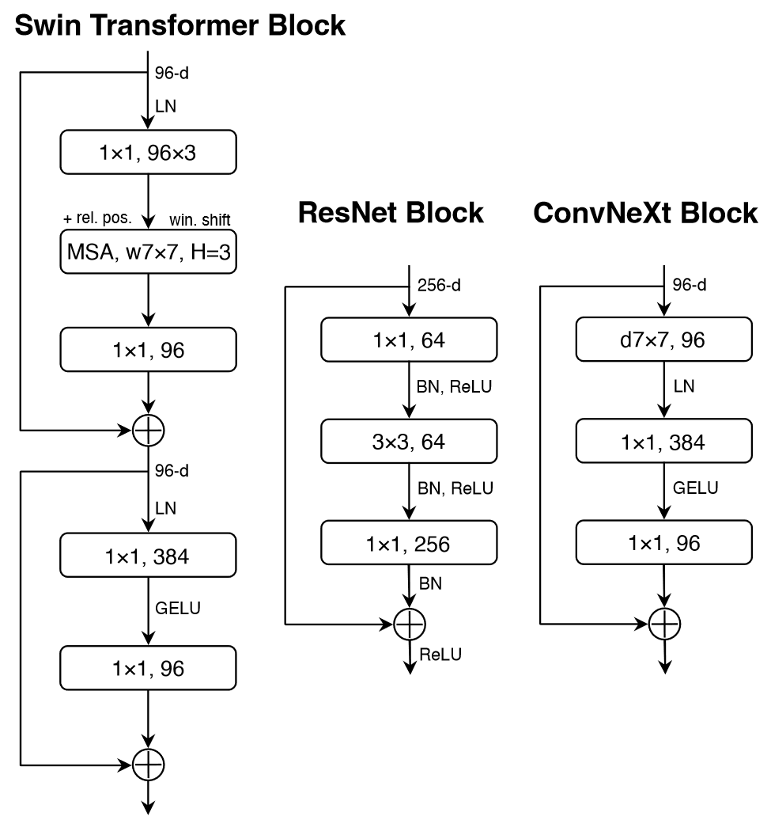

Slide 7
